Slide 1
3D Image Segmentation and Quantification of Lysosomes
24/11/2025

Slide 2
FILES
Airy scan_40A_UAS-TMEM-HA_CB_0h_1_051222
Airy scan_40A_UAS-TMEM-HA_CB_0h_2_051222
Airy scan_40A_UAS-TMEM-HA_CB_4h_1_051222
Airy scan_40A_UAS-TMEM-HA_CB_4h_2_051222
TMEM-HA 6h CB airy_3_170722
40A_UAS-TMEM192-3xHA x 40A 71G10 MARCM_around 12h - for quantification_4 Airy-CBs_300425
40A_UAS-TMEM192-3xHA x 40A 71G10 MARCM_around 12h - for quantification_3 Airy-CBs_300425
40A_UAS-TMEM1923x-HA x 71G10 40A MARCM_L3_2_Airy_010724
40A_UAS-TMEM1923x-HA x 71G10 40A MARCM_L3_1_Airy_010724

Slide 3
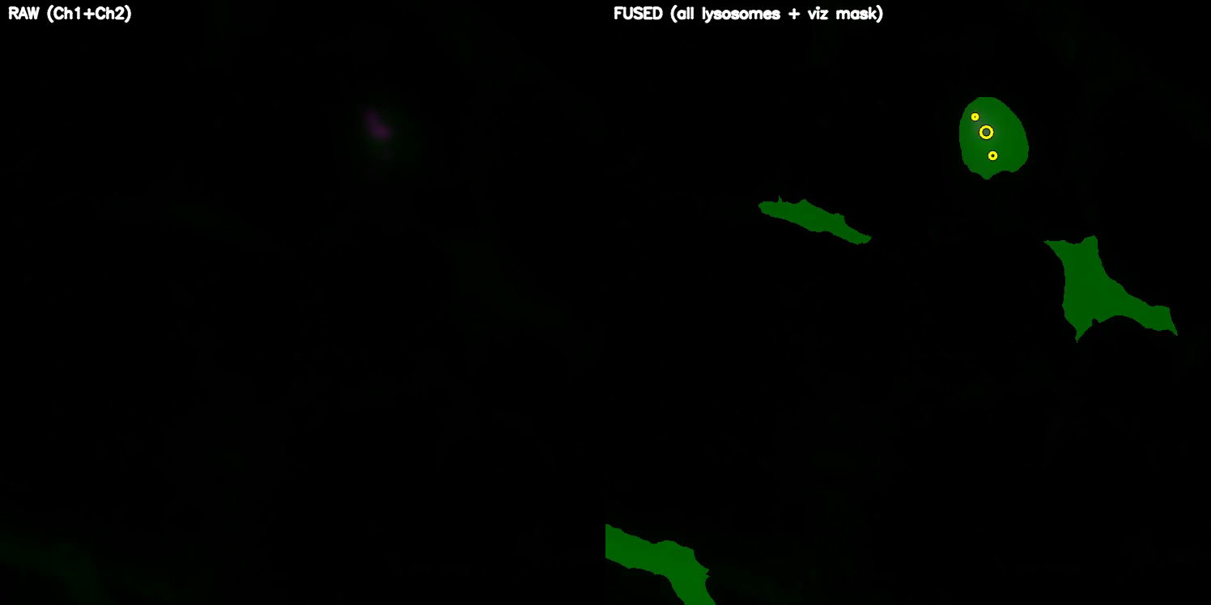
Airy scan_40A_UAS-TMEM-HA_CB_0h_1_051222

Slide 4
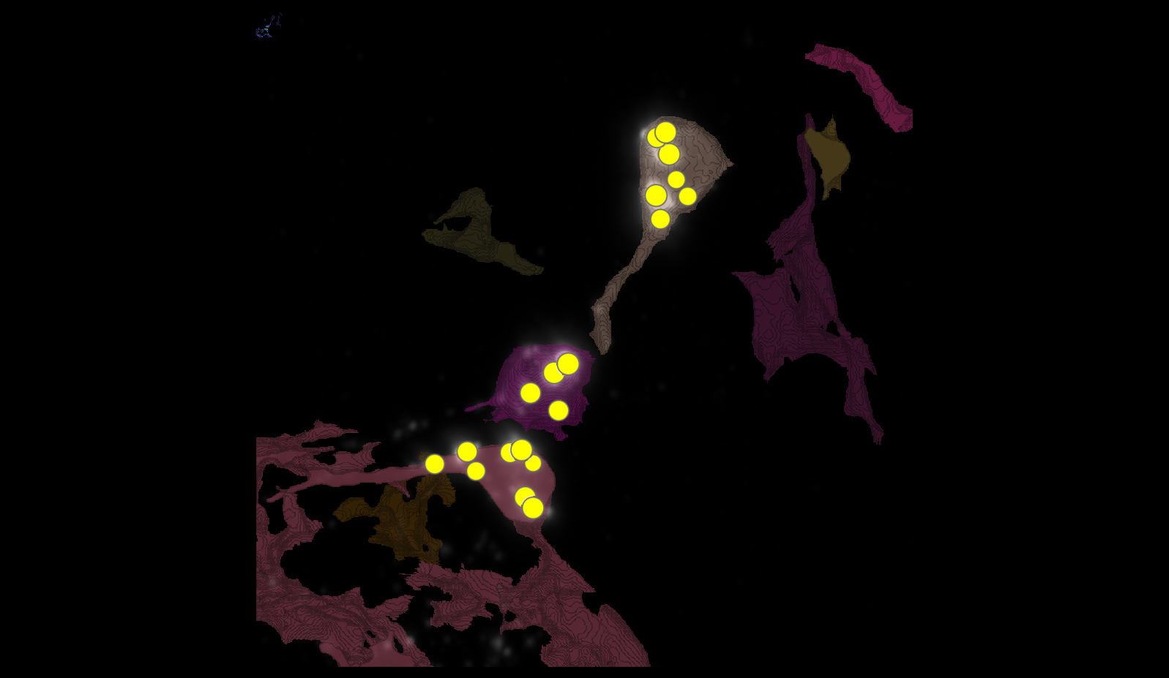
Airy scan_40A_UAS-TMEM-HA_CB_0h_1_051222

Slide 5
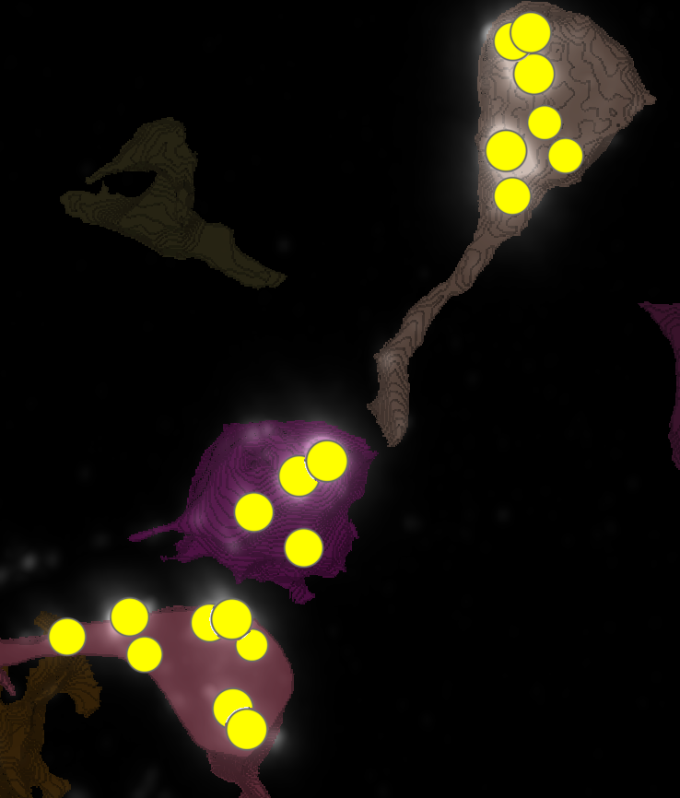
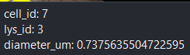
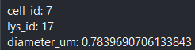
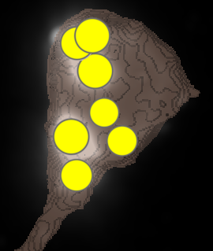
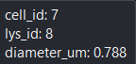
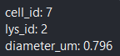
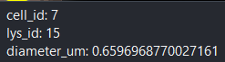
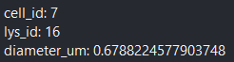
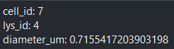
Airy scan_40A_UAS-TMEM-HA_CB_0h_1_051222

Slide 6
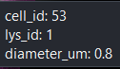
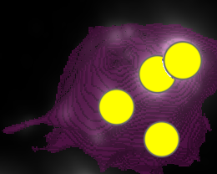
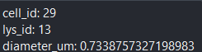
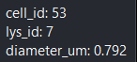
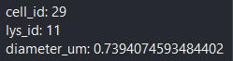
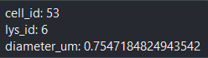
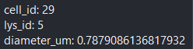
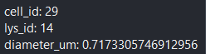
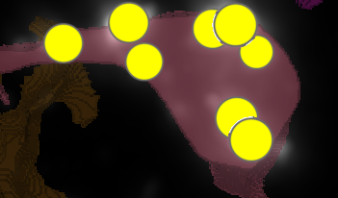
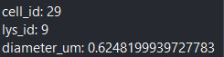
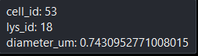
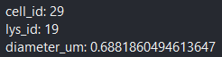
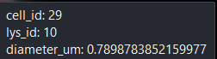
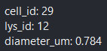
Airy scan_40A_UAS-TMEM-HA_CB_0h_1_051222

Slide 7
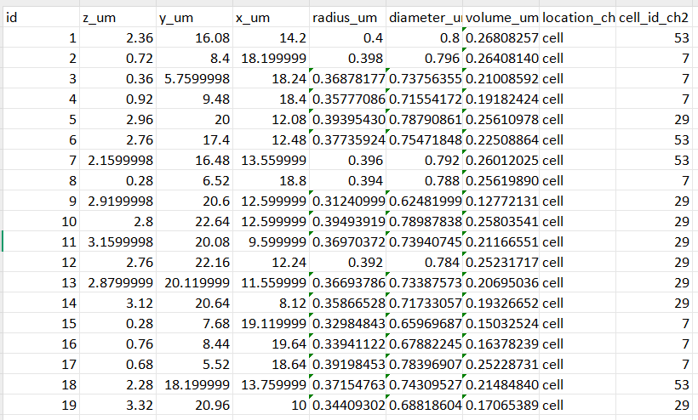
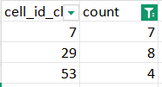
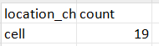
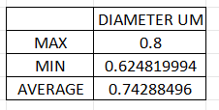
Airy scan_40A_UAS-TMEM-HA_CB_0h_1_051222

Slide 8
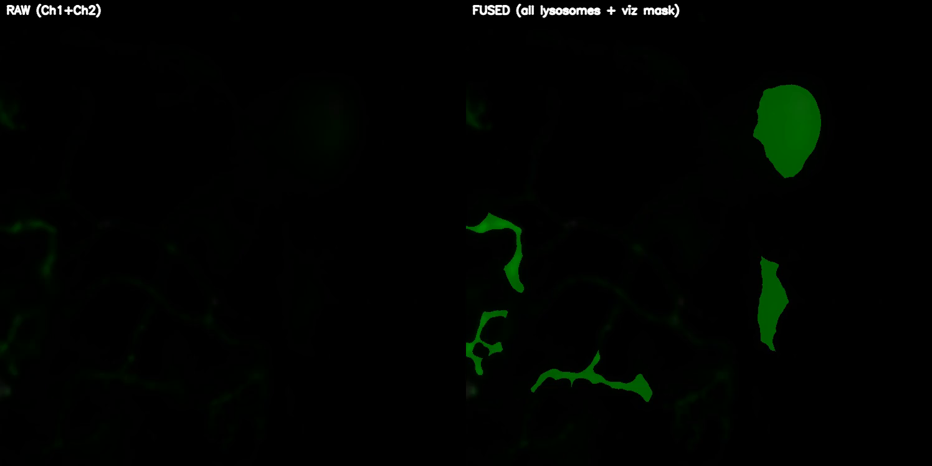
Airy scan_40A_UAS-TMEM-HA_CB_0h_2_051222

Slide 9
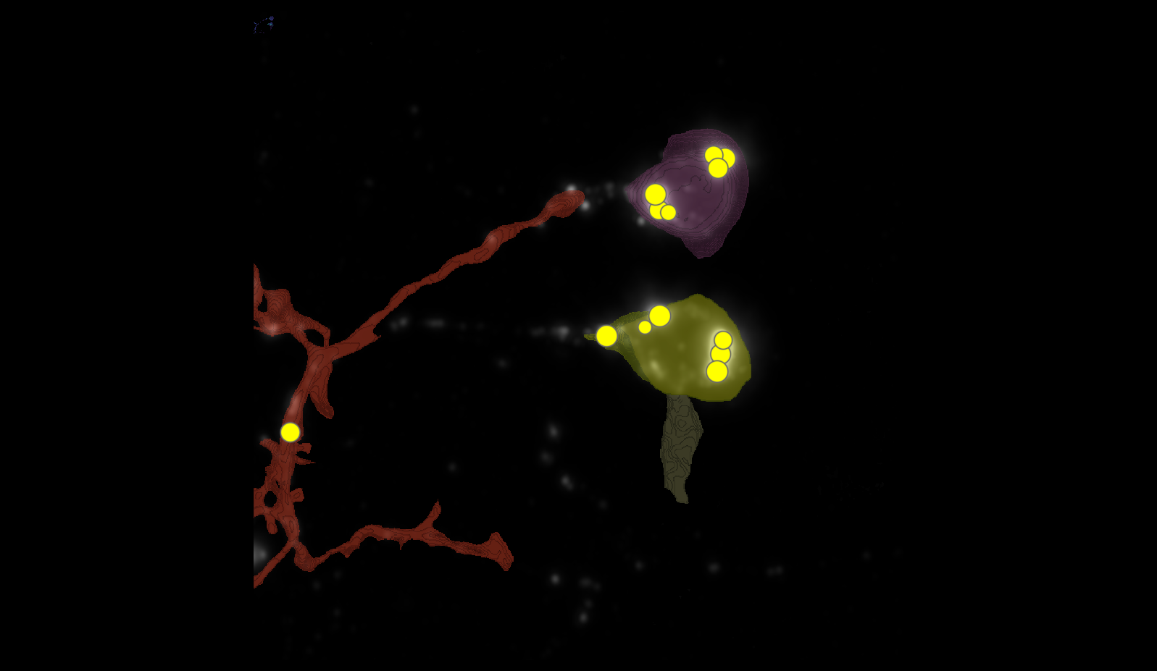
Airy scan_40A_UAS-TMEM-HA_CB_0h_2_051222

Slide 10
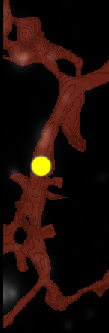
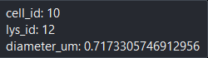
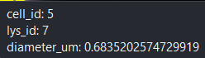
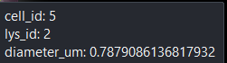
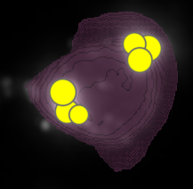
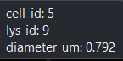
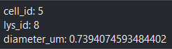
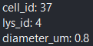
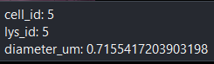
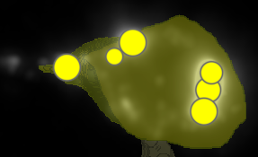
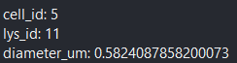
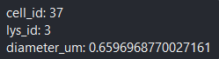
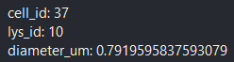
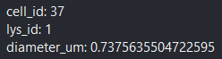
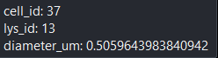
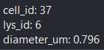
Airy scan_40A_UAS-TMEM-HA_CB_0h_2_051222

Slide 11
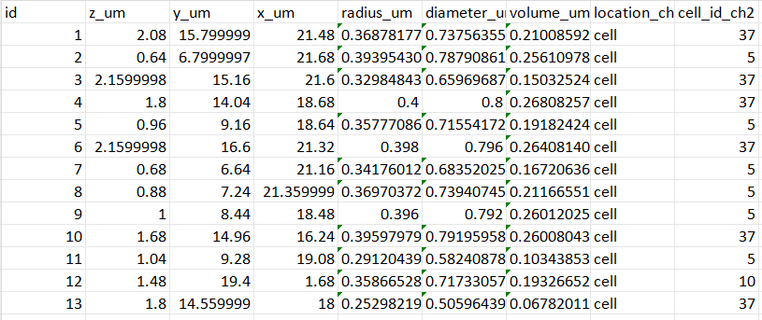
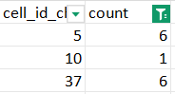
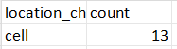

Airy scan_40A_UAS-TMEM-HA_CB_0h_2_051222

Slide 12

Airy scan_40A_UAS-TMEM-HA_CB_4h_1_051222

Slide 13

Airy scan_40A_UAS-TMEM-HA_CB_4h_1_051222

Slide 14



























Airy scan_40A_UAS-TMEM-HA_CB_4h_1_051222

Slide 15




Airy scan_40A_UAS-TMEM-HA_CB_4h_1_051222

Slide 16

Airy scan_40A_UAS-TMEM-HA_CB_4h_2_051222

Slide 17

Airy scan_40A_UAS-TMEM-HA_CB_4h_2_051222

Slide 18



























Airy scan_40A_UAS-TMEM-HA_CB_4h_2_051222

Slide 19




Airy scan_40A_UAS-TMEM-HA_CB_4h_2_051222

Slide 20

TMEM-HA 6h CB airy_3_170722

Slide 21

TMEM-HA 6h CB airy_3_170722

Slide 22







































TMEM-HA 6h CB airy_3_170722

Slide 23






















TMEM-HA 6h CB airy_3_170722

Slide 24


























TMEM-HA 6h CB airy_3_170722

Slide 25





TMEM-HA 6h CB airy_3_170722

Slide 26

40A_UAS-TMEM192-3xHA x 40A 71G10 MARCM_around 12h - for quantification_4 Airy-CBs_300425

Slide 27

40A_UAS-TMEM192-3xHA x 40A 71G10 MARCM_around 12h - for quantification_4 Airy-CBs_300425
lys_id:2
lys_id:1
lys_id:3

Slide 28




40A_UAS-TMEM192-3xHA x 40A 71G10 MARCM_around 12h - for quantification_4 Airy-CBs_300425

Slide 29

40A_UAS-TMEM192-3xHA x 40A 71G10 MARCM_around 12h - for quantification_3 Airy-CBs_300425

Slide 30

40A_UAS-TMEM192-3xHA x 40A 71G10 MARCM_around 12h - for quantification_3 Airy-CBs_300425

Slide 31





















40A_UAS-TMEM192-3xHA x 40A 71G10 MARCM_around 12h - for quantification_3 Airy-CBs_300425

Slide 32




40A_UAS-TMEM192-3xHA x 40A 71G10 MARCM_around 12h - for quantification_3 Airy-CBs_300425

Slide 33

40A_UAS-TMEM1923x-HA x 71G10 40A MARCM_L3_1_Airy_010724

Slide 34

40A_UAS-TMEM1923x-HA x 71G10 40A MARCM_L3_1_Airy_010724

Slide 35

























40A_UAS-TMEM1923x-HA x 71G10 40A MARCM_L3_1_Airy_010724

Slide 36




40A_UAS-TMEM1923x-HA x 71G10 40A MARCM_L3_1_Airy_010724

Slide 37




40A_UAS-TMEM1923x-HA x 71G10 40A MARCM_L3_1_Airy_010724

Slide 38

40A_UAS-TMEM1923x-HA x 71G10 40A MARCM_L3_2_Airy_010724
28
96
45
2
85
95

Slide 39





40A_UAS-TMEM1923x-HA x 71G10 40A MARCM_L3_2_Airy_010724

